Slide 1
Database Replication
Reference: https://www.youtube.com/watch?v=jLEp1XI_L6Q&t=23s

Slide 2
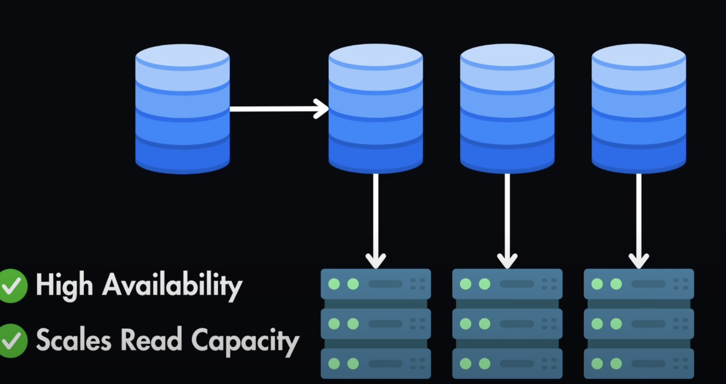
Database Replication is used to guarantee data AVAIABILITY => ensure the system remain responsive in case of high load or DB failures.
DB replication consists in creating multiple copies (called “REPLICAS”) of the same DB running on different servers (and machines).
Pros:
It guarantee High Availability because if one replica goes down, the system can switch to another replica providing uninterrupted services to clients.
It scales read capacity because now we have multiple databases where you can read data from

Slide 3
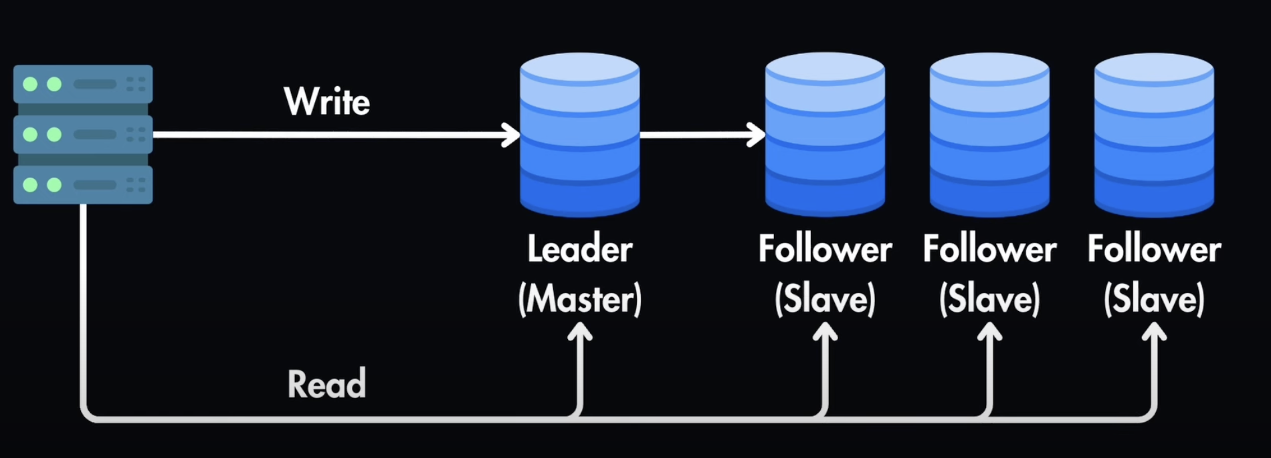
Leader-Follower Replication
Write operations are done only towards the Leader => it’s then the Leader responsible to propagate the changes to the followers
Read operations are spread across both Leader and Followers

Slide 4
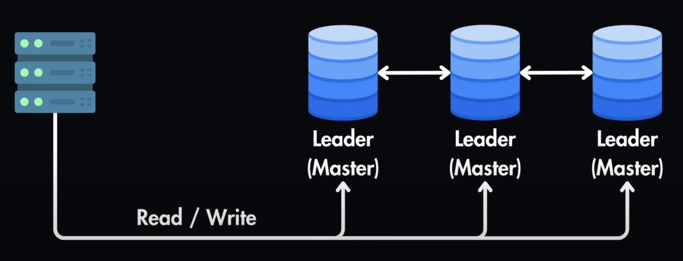
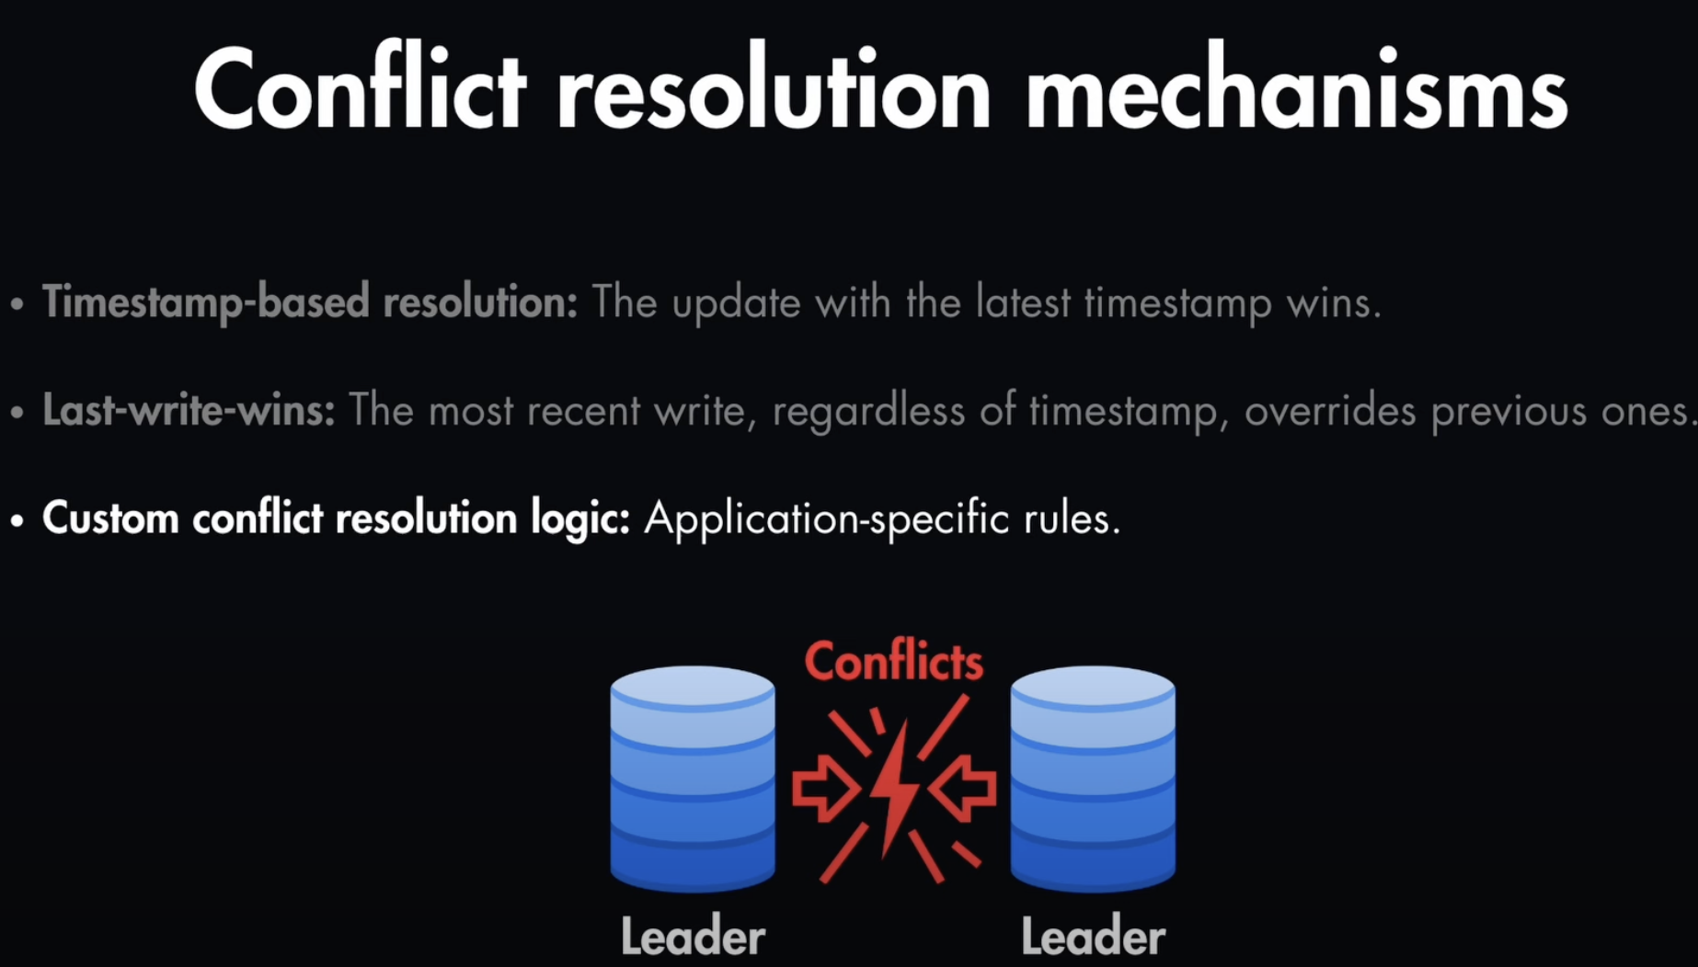
Leader-Leader Replication
Write and Read operations are can be done towards any of the replicas.
Problem of this approach:
- There might be conflicts when writing data in one of the Leader (for example a user update a record in DB1, while another user update the same record in DB2. There might be a conflict)=> we need to handle conflicts resolution mechanisms => There are 3 options ==>

Slide 5
Replication can be both Synchronous or Asynchronous
Sync Replication
Pros:
Changes are committed to both Leaders and Followers simultaneously
Guarantee consistency of the data
Con:
Slower than Async => impact the writes performance
Async Replication
Pros:
Sync is done in background
Faster than Sync replication
Con:
Temporarily Data inconsistency

Slide 6
Read-Write Quorum
Suppose you have a replication mechanism with 1 Leader and 2 Followers.
According to the read/write quorum, we need to guarantee:
W + R > N
Where:
W = the number of replicas where you write content before declaring a successful write operation
R = the number of replicas from where you read content before declaring a successful read operation
N = the total number of servers (in this case N = 3)
In a read heavy system you could decide that you want to to read from 2 servers only for a successful read and write to at least 2 servers to declare a successful write. Indeed, we would have:
2 + 2 > 3
If you add more nodes and have 1 Leader and 4 Followers (i.e. N=5), In a read heavy system you could decide that you want to to read from 2 servers only for a successful read and write to at least 4 servers to declare a successful write. Indeed, we would have:
4 + 2 > 5

